Slide 1
ML and AI in Cybersecurity Offense
Cybersecurity
Lesson 2.3

Slide 2
By the end of today’s class, you will:
1
Understand how AI is used in cybersecurity offense.
2
Learn about specific AI and ML techniques for offensive security.
3
Gain hands-on experience with AI tools used in cybersecurity offense.

Slide 3

AI and ML Techniques for
Cybersecurity Offense

Slide 4
Offensive security involves using AI and ML techniques to simulate cyber attacks.

Slide 5


Common Applications Using AI in Offensive Cybersecurity
Penetration Testing
Identifying specific vulnerabilities in a system or application.
Red Teaming
Testing overall security posture and response capabilities.

Slide 6

Automated Exploitation Generation
Helps identify vulnerabilities
Analyzes software
Generates exploits
Speeds up process

Slide 7

Phishing Campaign Automation
Increases effectiveness of phishing campaigns
Crafts and sends phishing emails
Adjusts based on recipient response
Adapts and improves overtime

Slide 8

Social Engineering
Crafts personalized attack vectors
Gathers and analyzes detailed information
Uses various social media platforms
Designs effective attacks

Slide 9
Examples of AI and ML Applications in Offensive Security
Penetration testing tools
Phishing simulation platforms
Advanced persistent threat (APT) simulations
AI-driven tools like automated vulnerability scanners identify and exploit system weaknesses, providing a comprehensive security assessment.
AI-powered platforms simulate phishing attacks to train employees on recognizing and responding to phishing attempts.
AI tools that simulate APTs test organizational defenses against prolonged and sophisticated cyber attacks.

Slide 10

AI and ML for Automated
Vulnerability Scanning

Slide 11
Automated vulnerability scanning involves using specialized tools to identify security vulnerabilities in systems, networks, and applications.

Slide 12



Understanding Automated Vulnerability Scanning
01
02
03
Unpatched software
Misconfigurations
Potential exploit points
Notes:
Shutterstock_792833623 shutterstock_693068344 shutterstock_693068344.png

Slide 13
AI and ML Enhances Vulnerability Scanning
AI can assess the potential impact and exploitability of vulnerabilities, and prioritize remediation efforts accordingly.
AI and ML improve the effectiveness of vulnerability scans.
Prioritization of vulnerabilities helps resource optimization for remediation.

Slide 14
Key AI and ML Techniques for Vulnerability Scanning
Pattern recognition
AI can identify
known vulnerabilities by matching patterns
in code against
a database of
known issues.
Anomaly detection
AI can identify unusual patterns that could indicate novel vulnerabilities.
Predictive analysis
Historical data
is used to forecast future potential vulnerabilities and prioritize them based on likelihood of being exploited.

Slide 15

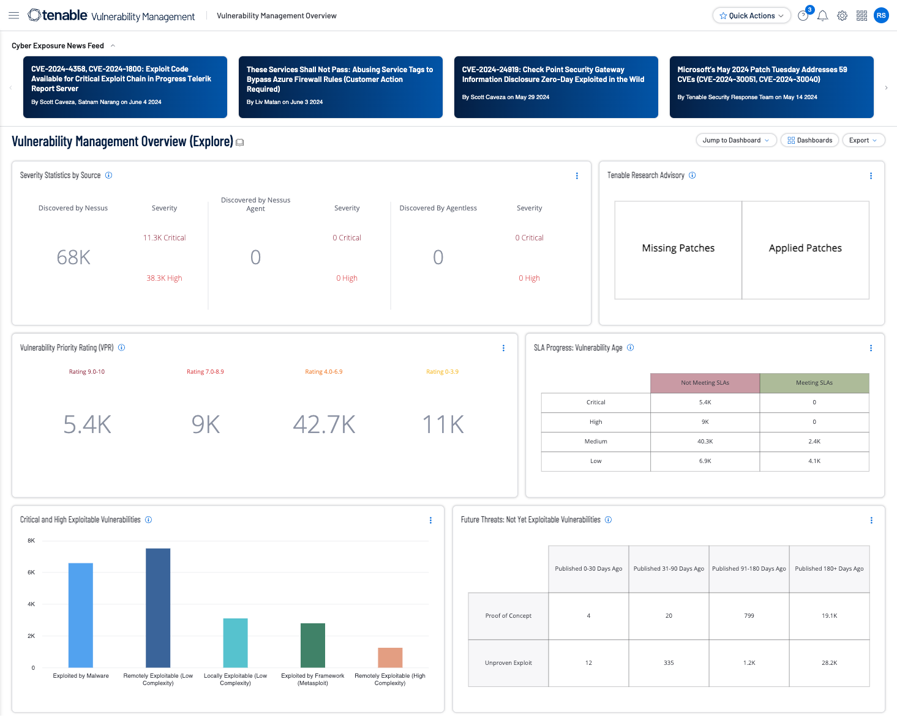
AI and ML Applications in Vulnerability Scanning
Tenable.io & Rapid7 InsightVM
Identification of weaknesses
Prioritization of vulnerabilities
Continuous monitoring
Automated assessments

Slide 16


AI and ML Applications in Vulnerability Scanning
Automated Scanners with AI Integration
Assessment of security posture
Real-time assessments
Adaptation to new threats
Up-to-date information

Slide 17
APT Threat Analysis

Slide 18

ChatGPT: “Summarize APT 29.”

Slide 19
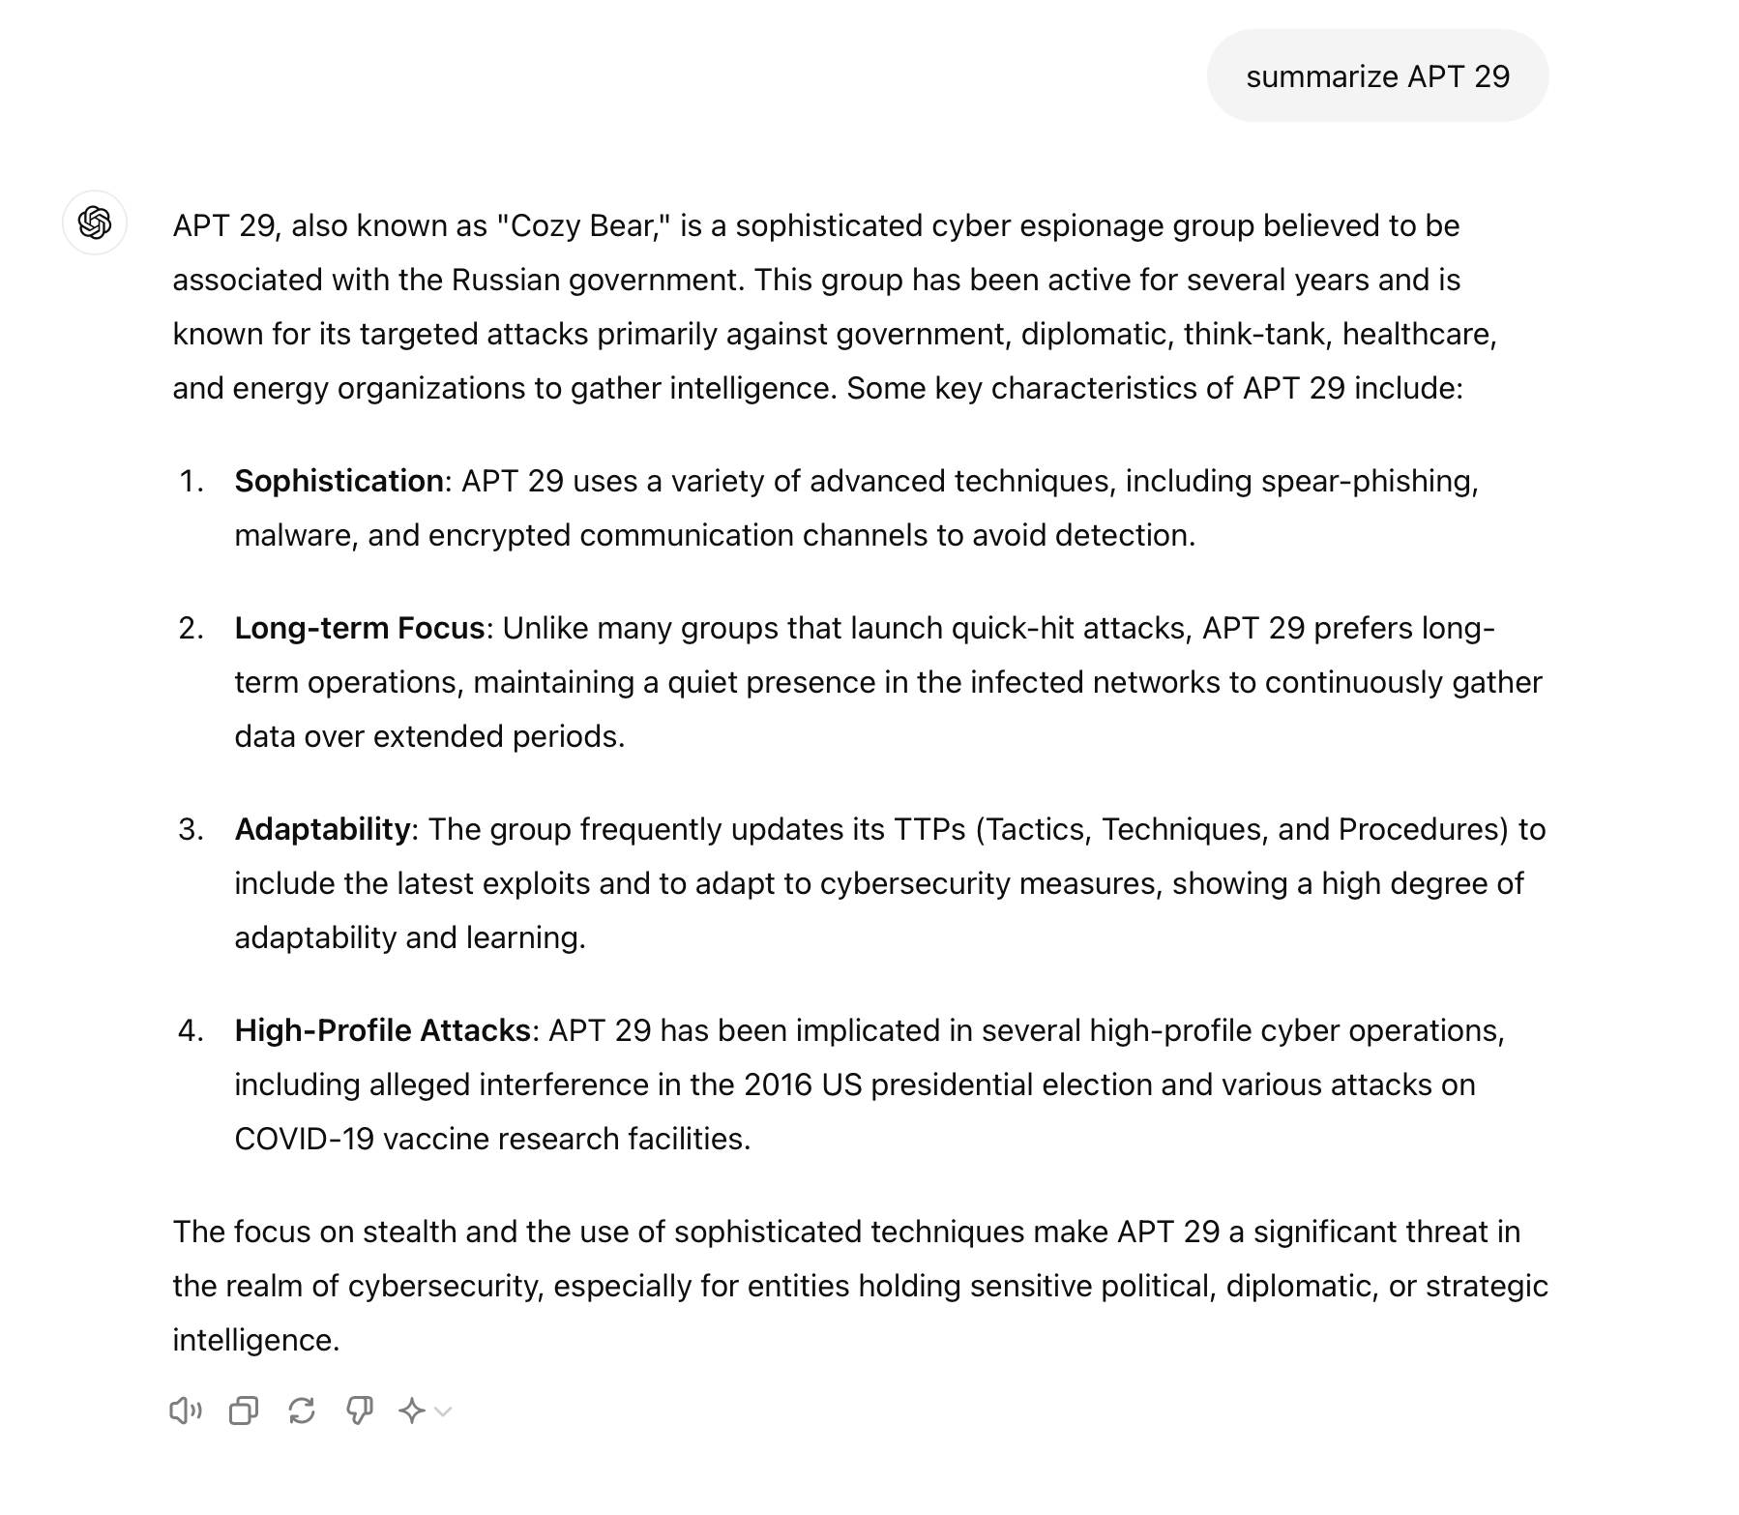

Slide 20
Analyzing APTs with AI
In this activity, you will be researching APT threats targeting financial organizations and summarizing the results using ChatGPT.
20 Minutes

Slide 24
AI Techniques for
Automated Exploit Generation

Slide 25
Exploit generation involves creating code or techniques designed to take advantage of vulnerabilities in software, systems, or networks.

Slide 26
The primary goal of exploit generation is to demonstrate the potential impact of a vulnerability and to help security professionals understand how it can be mitigated.

Slide 27
How does AI and ML enhance exploit generation?

Slide 28

AI and ML Enhances Exploit Generation
Key benefits:
Speed and efficiency
Accuracy
Thorough analysis
Deeper insights
Complex vulnerabilities: AI can identify complex and subtle vulnerabilities that human analysts might miss.

Slide 29
Key AI and ML Techniques for Exploit Generation
Machine learning for vulnerability detection
Automated exploit development
Fuzzing
Using ML to identify vulnerabilities
Example: Training ML on a dataset of known vulnerabilities
Using AI to generate exploits for vulnerabilities
Example: Using reinforcement learning to optimize exploit code
Testing technique inputting random or unexpected data
Example: Using genetic algorithms to evolve inputs to test software issues

Slide 30

Examples of AI/ML Applications in Exploit Generation
Advanced AI modules can help in exploit generation
OpenAI’s GPT-4:
Analyzes vulnerabilities
Generates exploit code
AI-powered fuzzing tools:
Tests for weaknesses
Generates reports
Provides actionable insights

Slide 31
AI and ML Tools for Exploit Generation

Slide 32
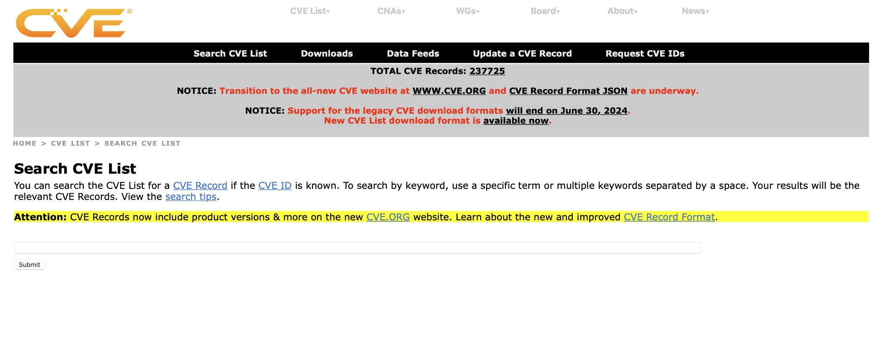
Common Vulnerabilities and Exposure
cve.mitre.org

Slide 33
Common vulnerabilities and exposures (CVE) is a list of publicly disclosed computer security flaws.

Slide 34
Common Vulnerabilities and Exposures
Provides a standardized identifier for a vulnerability
Widely used in the cybersecurity industry to quickly and accurately share information about vulnerabilities
Information relates to nature of vulnerabilities, systems affected, and degree of criticality
Tracks vulnerability metrics and manages patches and updates to mitigate threats

Slide 35
You are not expected to understand all of these concepts right now, as they will be covered in upcoming classes.

Slide 36
Generating Exploits with AI
In this activity, you will be using ChatGPT and WhiteRabbitNeo to generate an exploit to analyze.
20 Minutes

Slide 40

Recap
ML and AI in Cybersecurity Offense
01
We discussed how AI is used in cybersecurity offense.
02
You learned about specific AI/ML techniques for offensive security.
03
You explored AI tools used in cybersecurity offense.

Slide 41
We will discuss basic Linux systems and the command line, looking into distros and file structures.

